Slide 1
Capstone Project IBM Data Science Professional Certificate
By: Ashna Rafeek

Slide 2
Business problem
The objective of this project is to analyze and provide the best locations in Toronto, Canada for a new Japanese Restaurant. Utilizing data science methodology and analysis along with instruments the project aims to provide solution to: “Where in Toronto potential investors can open a Japanese Restaurant?”

Slide 3
data
Data description:
Toronto, canada data containing neighborhoods and boroughs
Latitude and longitude coordinates of these neighborhoods for plotting the map
Venue data, namely restaurants data of toronto
Data source:
Toronto data source for neighborhoods and boroughs will be obtained from wikipedia and wrangled with python pandas library. Further, we will retrieve geographical coordinates (latitude, longitude) from the website: http://cocl.us/Geospatial_data provided by ibm.
Additionally, we are going to use foursquare api to get venue data for the neighborhoods.

Slide 4
methodology
Collect the data from sources. Clean and process the data
Using Foursquare API, locate all venues filtering by Japanese Restaurants
Ranking and Likes factors will be counted to sort the data based on those
Visualize data utilizing
Python graphic libraries

Slide 5
results
Downtown Toronto has highest number of Japanese Restaurants compared to other Boroughs
Downtown Toronto has highest average rating for the Japanese Restaurants
Another highest average rating has in West Toronto
however number of
Restaurants are few

Slide 6
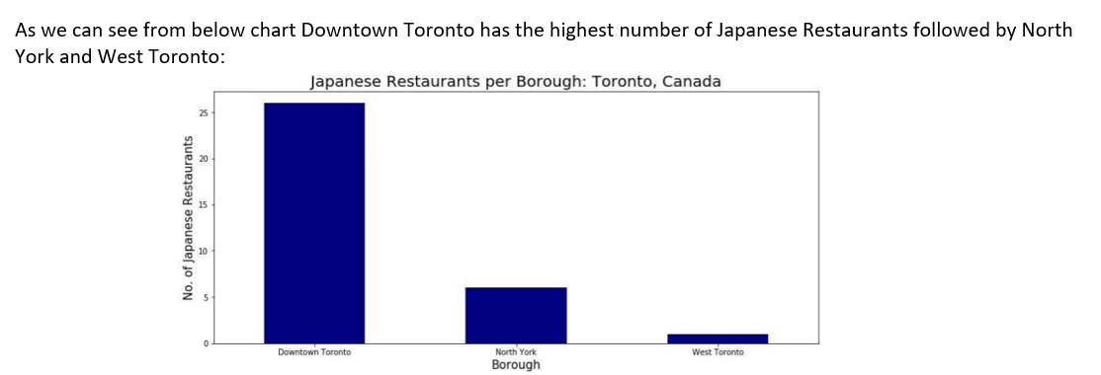

Slide 7
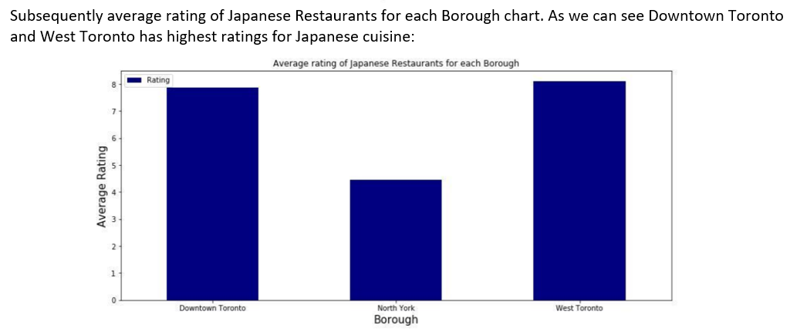

Slide 8
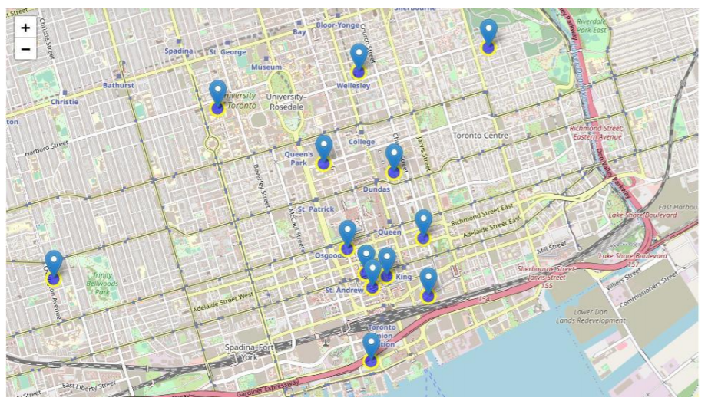

Slide 9
discussions
Based on the results of our analysis Downtown and West of Toronto are the best locations for Japanese cuisine in Toronto, Canada
West Toronto is more promising location with fewer competitors
Other locations are excluded as having a very low customer ratings

Slide 10
conclution
The findings of this project is applicable in real life. Improvements and additional criterion are suggested to apply for better results.
We have answered our question suggesting West Toronto the best location to invest into new Japanese Restaurant in the area. The findings of this is applicable to real life. Improvements and additional criterion are suggested to apply for better results

